Slide 1
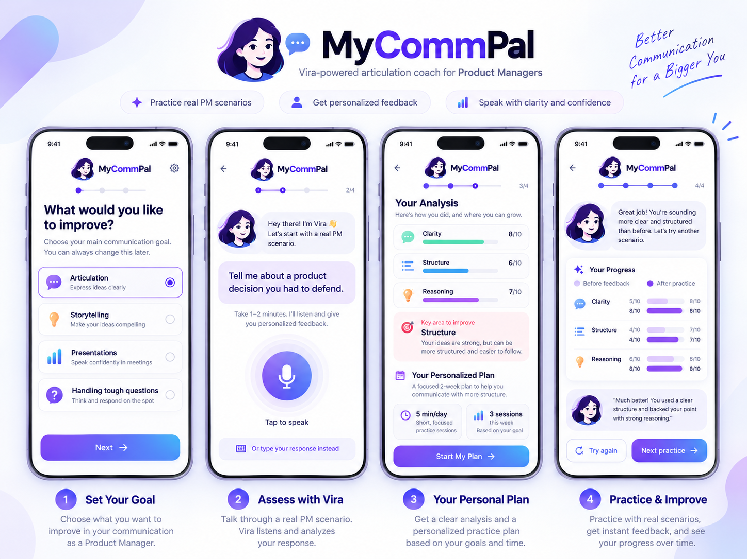
MYCOMMPAL / BUILDATHON
Great product thinking deserves clear communication.
Meet Vira — your personal AI communication mentor for Product Managers.
The promise
Diagnose one gap. Learn one technique. Practice again. See the difference.
mycommpal.vercel.app
Illustrative product journey visual
“For practice I would use Vira.” — early tester
MyCommPal • 1
Notes:
Open with the PM pain point. The image is a concept visual from the original prototype, not proof of the current live UI. Keep the live demo authoritative.

Slide 2
MYCOMMPAL / BUILDATHON
The problem is clear, specific, and real.
PMs often know the answer—but struggle to articulate it clearly in the room.
9 of 14
Current workaround
Why that fails
Career impact
participants in user research reported articulation-related challenges.
Notes, self-practice, polite colleague feedback, generic ChatGPT prompts, videos and books.
They prepare content, but not delivery. Feedback is generic, delayed, or too polite.
A strong recommendation can sound vague, scattered, or weak under pressure.
Problem statement
Hypothesis
A working Product Manager struggles to explain product thinking clearly in high-pressure stakeholder conversations because they get too little realistic practice and too little specific feedback on what is not landing.
If we give PMs a safe place to rehearse realistic scenarios, diagnose their biggest articulation gap, and coach one better retry, they will communicate more clearly and confidently.
This is why MyCommPal focuses on articulation—not broad public speaking.
MyCommPal • 2
Notes:
Keep this slide tight. Emphasize the root issue: PM influence depends on clear reasoning, not just speaking confidence.

Slide 3
WEB APP / MOBILE-RESPONSIVE
One mentoring journey. Any screen.
MyCommPal runs in the browser on desktop and mobile — the same four-step experience adapts to the screen.
https://mycommpal.vercel.app/
MyCommPal
MyCommPal
Your practice journey
Your personal AI communication mentor
01
My Goal
01
02
03
04
02
Assess Me
My Goal
Assess Me
My Plan
Practice
Choose focus
Respond
Learn one technique
Compare
03
My Plan
04
Practice
DESKTOP WEB
MOBILE WEB
One experience • Responsive browser layout • No app installation
Illustrative responsive layout; live site is the source of truth.
MyCommPal • 3
Notes:
Clarify that MyCommPal is a responsive web application, not a native mobile app. The desktop and mobile panels are schematic illustrations of the same four-step flow. Demonstrate the current live site for actual UI.

Slide 4
MYCOMMPAL / BUILDATHON
Why MyCommPal is different
Generic LLMs
General speaking tools
MyCommPal
• Can roleplay if the user prompts well
• Often generate answers for you
• Feedback may be generic or inconsistent
• Strong substitute, but not a ready-made improvement loop
• Good at pace, filler words, and confidence cues
• Useful for broad speaking practice
• Usually weak at judging product reasoning and trade-offs
• PM-specific situations
• Evaluates clarity, structure, conciseness
• Adds product decision intelligence: decision, evidence, trade-off, impact
• Guides one focused retry instead of only rewriting the answer
MyCommPal’s edge is not “AI feedback.” It is the focused improvement loop for PM articulation.
MyCommPal • 4
Notes:
This slide answers the “why not just use ChatGPT?” question. The answer is: MyCommPal is pre-structured for PM articulation practice and diagnosis.

Slide 5
WHAT WE CHOSE NOT TO BUILD
MVP scope: one skill, one complete loop
IN SCOPE — THE CORE BET
OUT OF SCOPE — DELIBERATELY
• Select PM communication goal and scenario
• Capture baseline by text or speech
• Assess core articulation + relevant PM decision dimensions
• Learn one targeted technique
• Retry and compare attempts
• Collect real user feedback
• Video and body-language analysis
• Live, interruptible stakeholder voice simulation
• Full public-speaking courses and anxiety treatment
• Enterprise integrations and team dashboards
• Advanced long-term learning analytics and gamification
Trade-off: prove that one focused mentoring cycle creates value before broadening the platform.
MyCommPal • 5
Notes:
The jury evaluates scope discipline. We intentionally excluded broad speaking courses, video analysis, real-time interruptible conversations, enterprise integrations, and gamification to concentrate on one end-to-end PM articulation loop.

Slide 6
MYCOMMPAL / BUILDATHON
Demo flow: show improvement in one conversation
DEMO SCENARIO
Executive review: propose prioritizing onboarding over reporting, explain why now, and state the decision needed from leadership.
Baseline attempt
Practice 1
Practice 2
“Onboarding feels important. Reporting can wait.”
Vira detects: weak rationale, weak trade-off, low executive clarity.
“I recommend onboarding first because new users struggle to activate, and that slows adoption.”
Vira improves clarity and decision statement.
“We should prioritize onboarding now, defer non-critical reporting, and communicate the timeline. This improves activation sooner while containing reporting risk.”
Now the trade-off and impact land.
What the jury should see
Baseline → diagnosis → one focused technique → better retry. The innovation is the improvement loop, not just answer generation.
MyCommPal • 6
Notes:
Use your prepared baseline, practice 1, and practice 2 text here. Don’t promise a score—show what the app actually returns.

Slide 7
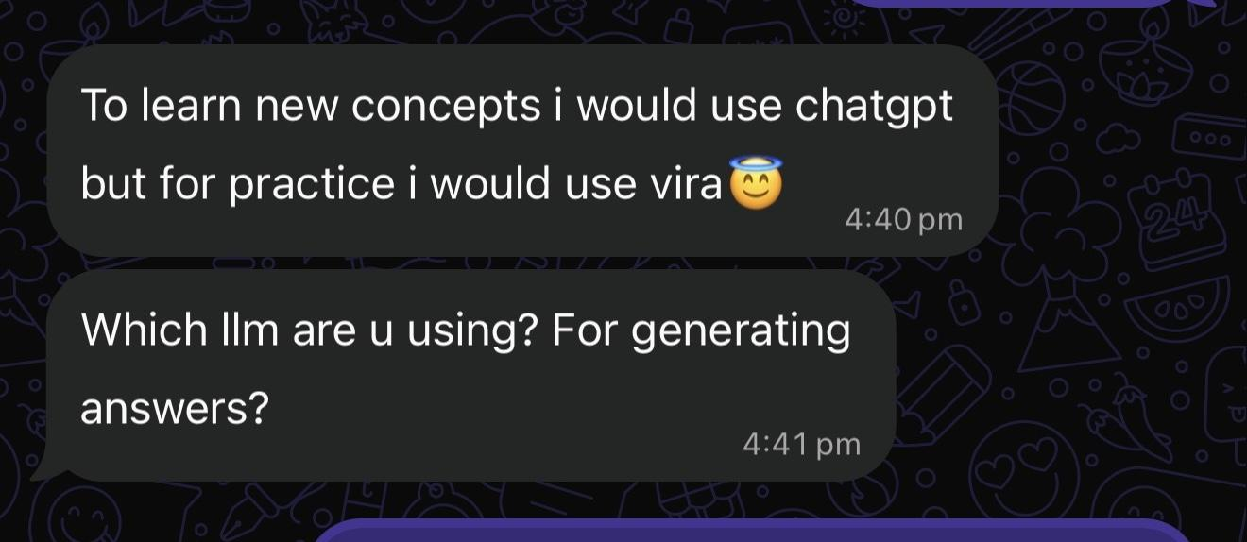
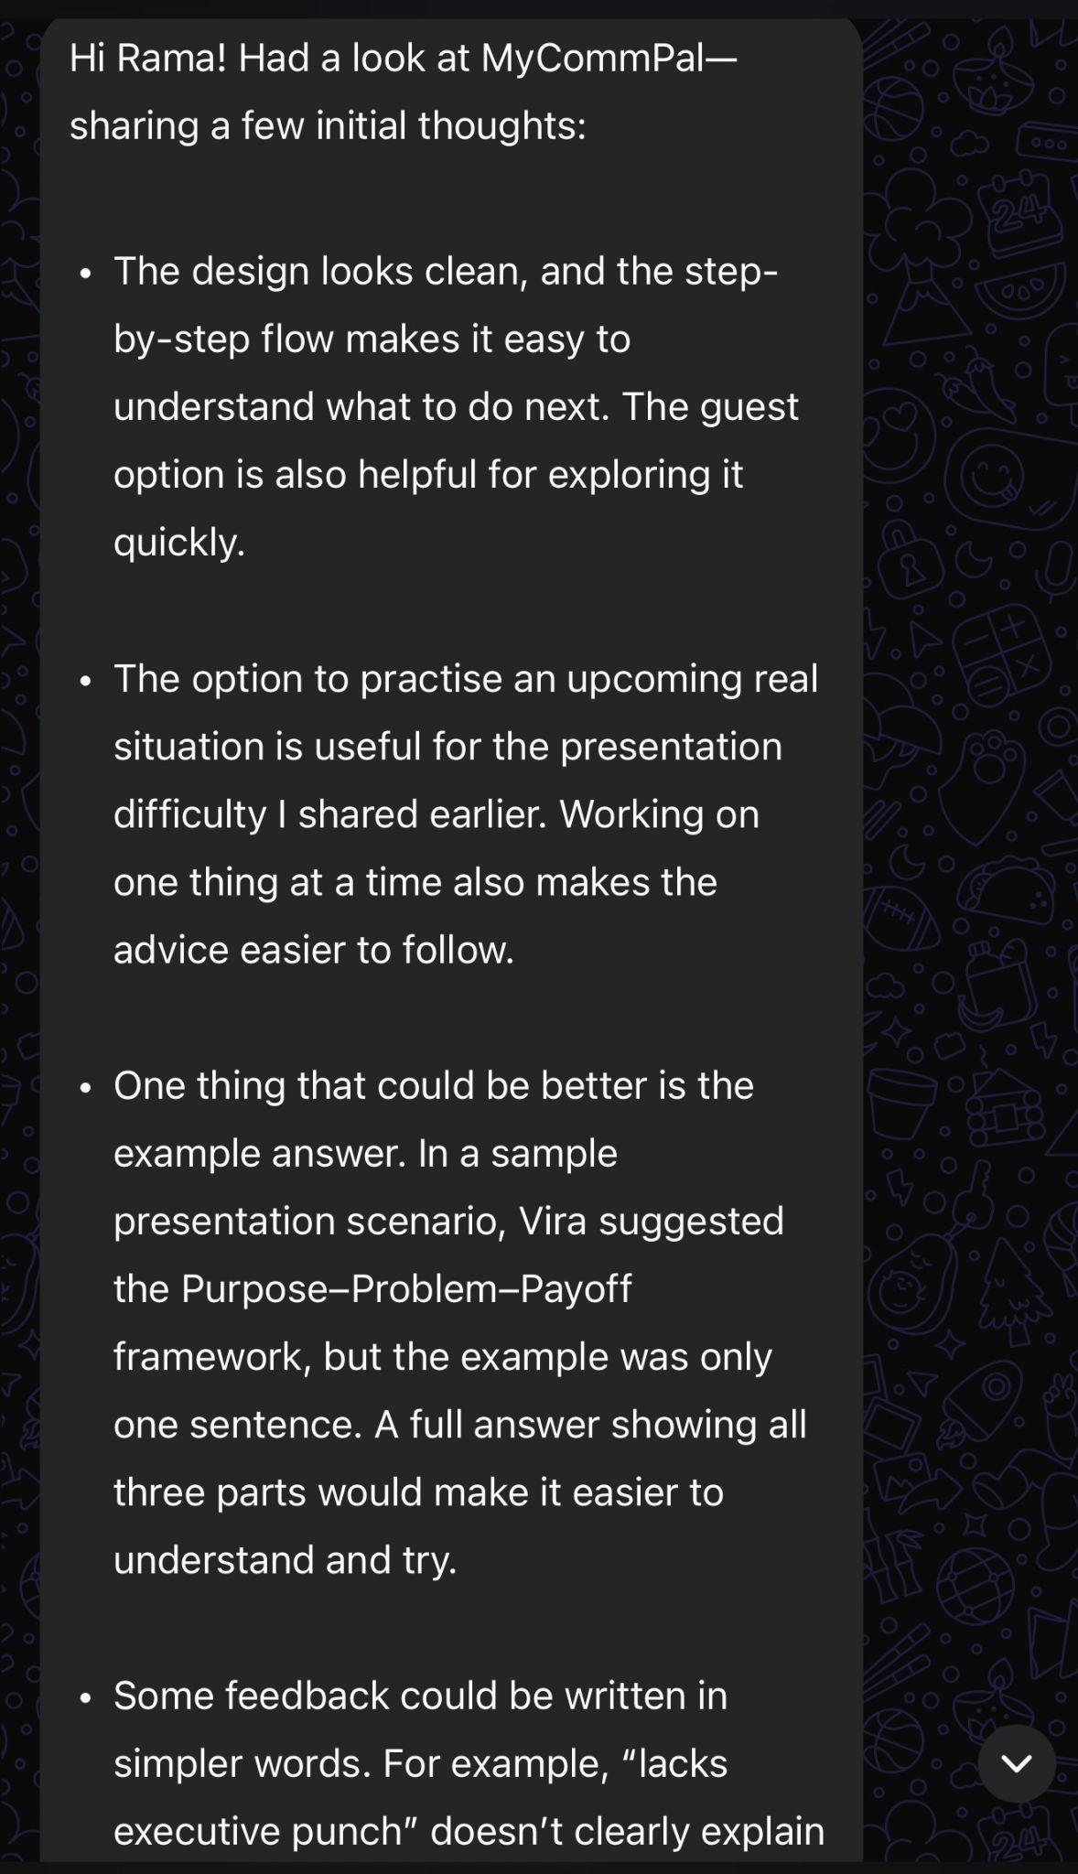
MYCOMMPAL / BUILDATHON
Real users: what resonated
What this tells us
• Users see a difference between learning concepts in ChatGPT and practising with Vira.
• The product already has a recognizable use case: rehearsal and feedback.
More positive signals
• Step-by-step flow felt easy to follow
• Guest mode reduced friction
• “One thing at a time” coaching made feedback easier to apply
• The “practise your real situation” option felt useful
These are early qualitative signals from real testers.
MyCommPal • 7
Notes:
Mention that the jury may not open the full evidence document, so this slide brings actual WhatsApp proof directly into the deck.

Slide 8
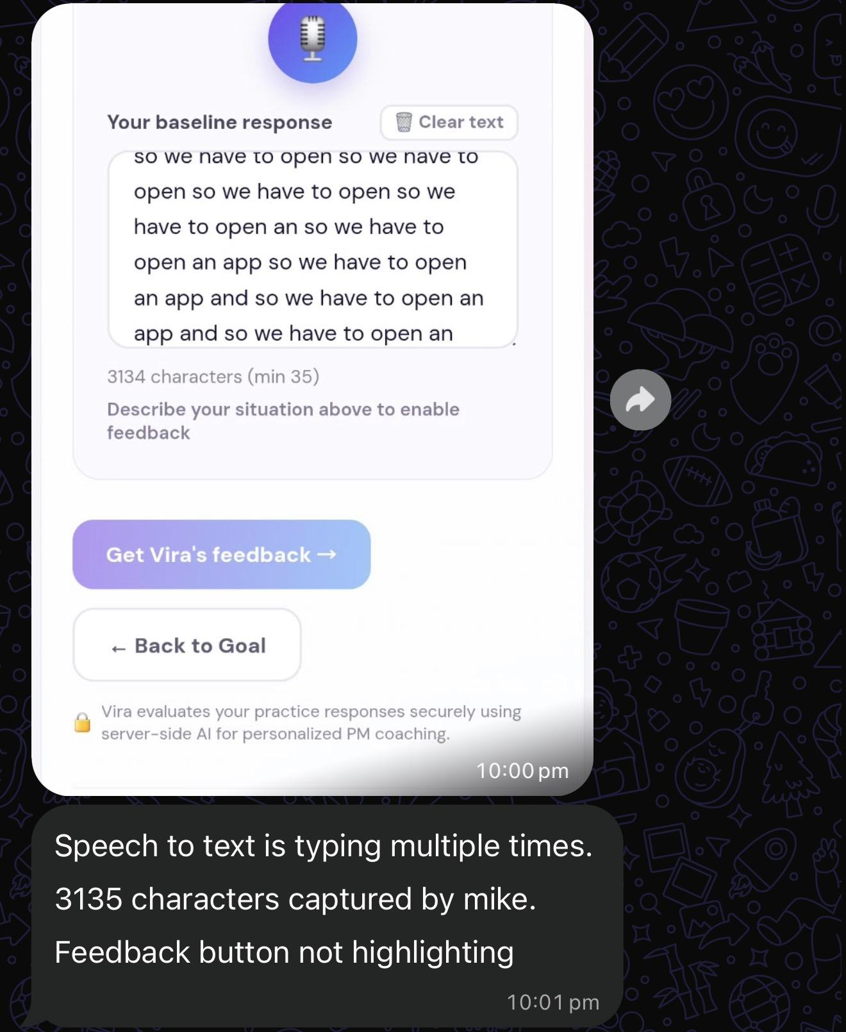
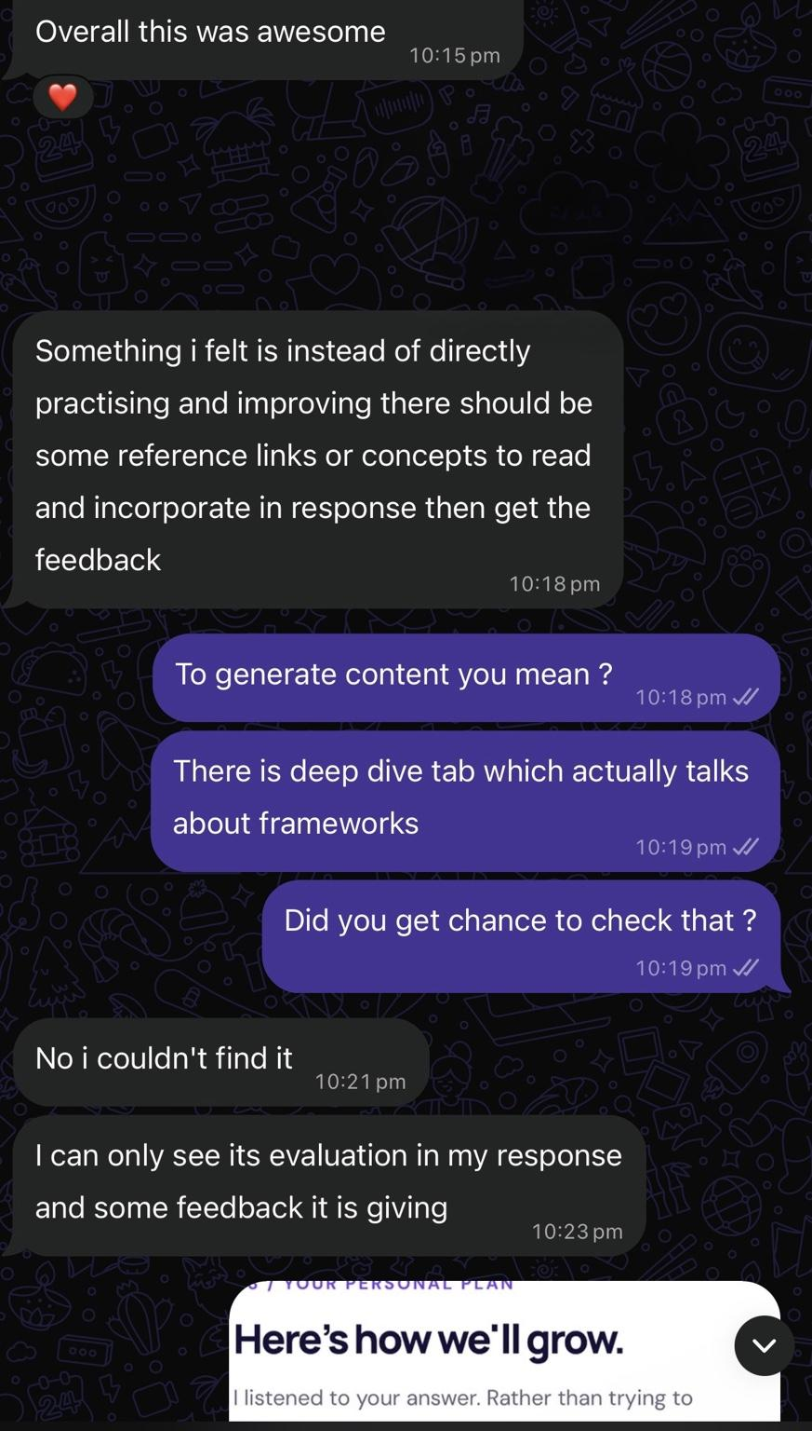
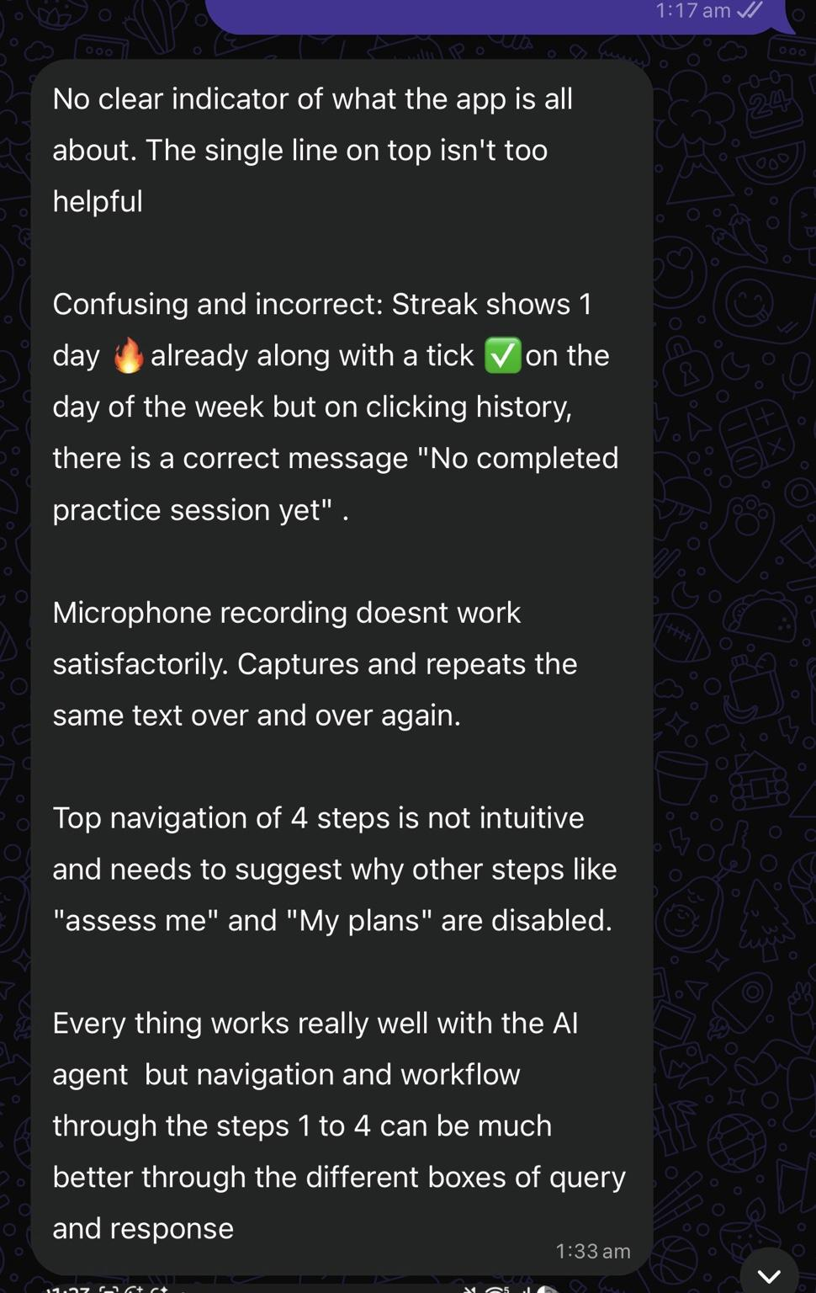
MYCOMMPAL / BUILDATHON
Real users: where they got stuck
Main friction themes
1. Voice input sometimes duplicated or stopped unexpectedly
2. Submission / comparison states were confusing in some flows
3. Framework content and deep-dive guidance were hard to discover
4. Landing page copy and step navigation needed to be clearer
Why this mattered
The tests helped us separate “good concept” from “good product.” Users liked the core value, but reliability and clarity shape trust.
MyCommPal • 8
Notes:
Show that you listened to user feedback honestly. This slide increases credibility because it includes real friction, not just praise.

Slide 9
MYCOMMPAL / BUILDATHON
Feedback changed the priorities—not the mission
What users valued
Changes reported in build
Still needs live retest
• Focused, step-by-step mentoring
• Real PM scenarios
• Guest access
• One improvement at a time
• Progressive disclosure of coaching
• Transcript deduplication logic
• Input and navigation handling
• Supabase session persistence
• Voice capture on real devices
• Practice comparison scores
• No previous-session carryover
• Accurate streaks and completion
• Discoverable technique examples
Reported fixes are based on implementation summary; production retest and 3–5 distinct tester records remain necessary.
MyCommPal • 9
Notes:
Be precise. The feedback is genuine, but do not tell the jury all defects were fixed unless the final production retest confirms it. Record distinct tester IDs.

Slide 10
MARKET ENTRY / VALIDATION
GTM plan: earn the first 10 advocates
Start with working PMs who have real stakeholder conversations to prepare for.
01 Recruit
02 Activate
03 Learn & iterate
Initial 10 PM users identified:
5 colleagues · 4 HelloPM peers · 1 friend.
Invite each to practise one real stakeholder scenario.
Use guest access and one immediate personalized insight. Ask testers to complete the baseline → plan → retry journey.
Collect usefulness ratings and WhatsApp feedback; verify friction fixes, compare retries, and invite users back before real meetings.
Bhavana · Vivek · Srikanth · Naresh · Santosh | Charith · Manav · Nikhil · Chinmay | Ratan
Launch metrics to test — not achieved results
10 named first users • Track completed sessions • Feedback usefulness • 14-day return
Live demo: mycommpal.vercel.app | Source: github.com/ramachinthapalli-ghub/mycommpal
MyCommPal • 10
Notes:
This is the operating plan behind AARRR. It is intentionally a focused validation launch, not an untested growth forecast. The live app and code link are visible here. Confirm guest access works from a fresh browser before jury submission.

Slide 11
GTM / FIRST 10 USERS
AARRR — The Growth Plan
A
A
R
R
R
Acquisition
Activation
Retention
Referral
Revenue
First 10 PMs
Aha in <2 min
Before real meetings
Share a useful result
Freemium hypothesis
5 colleagues + 4 HelloPM peers + 1 friend
One precise gap + actionable technique
Return for roadmap / VP conversation prep
Tell a PM colleague after a valuable retry
Paid ongoing mentoring + deeper practice
North Star: completed mentoring cycles
Baseline assessment → targeted guidance → one or more retries. GTM targets are hypotheses, not achieved funnel metrics.
MyCommPal • 11
Notes:
Show the jury an actual answer for all five AARRR stages. Emphasize event-driven retention over artificial daily usage. Monetization is not yet validated.

